Slide 1




Renewable Energy Educational Outreach
By Steven Tallas
Acknowledgements: Mansel Nelson
and Kathleen M. Stigmon

Slide 2
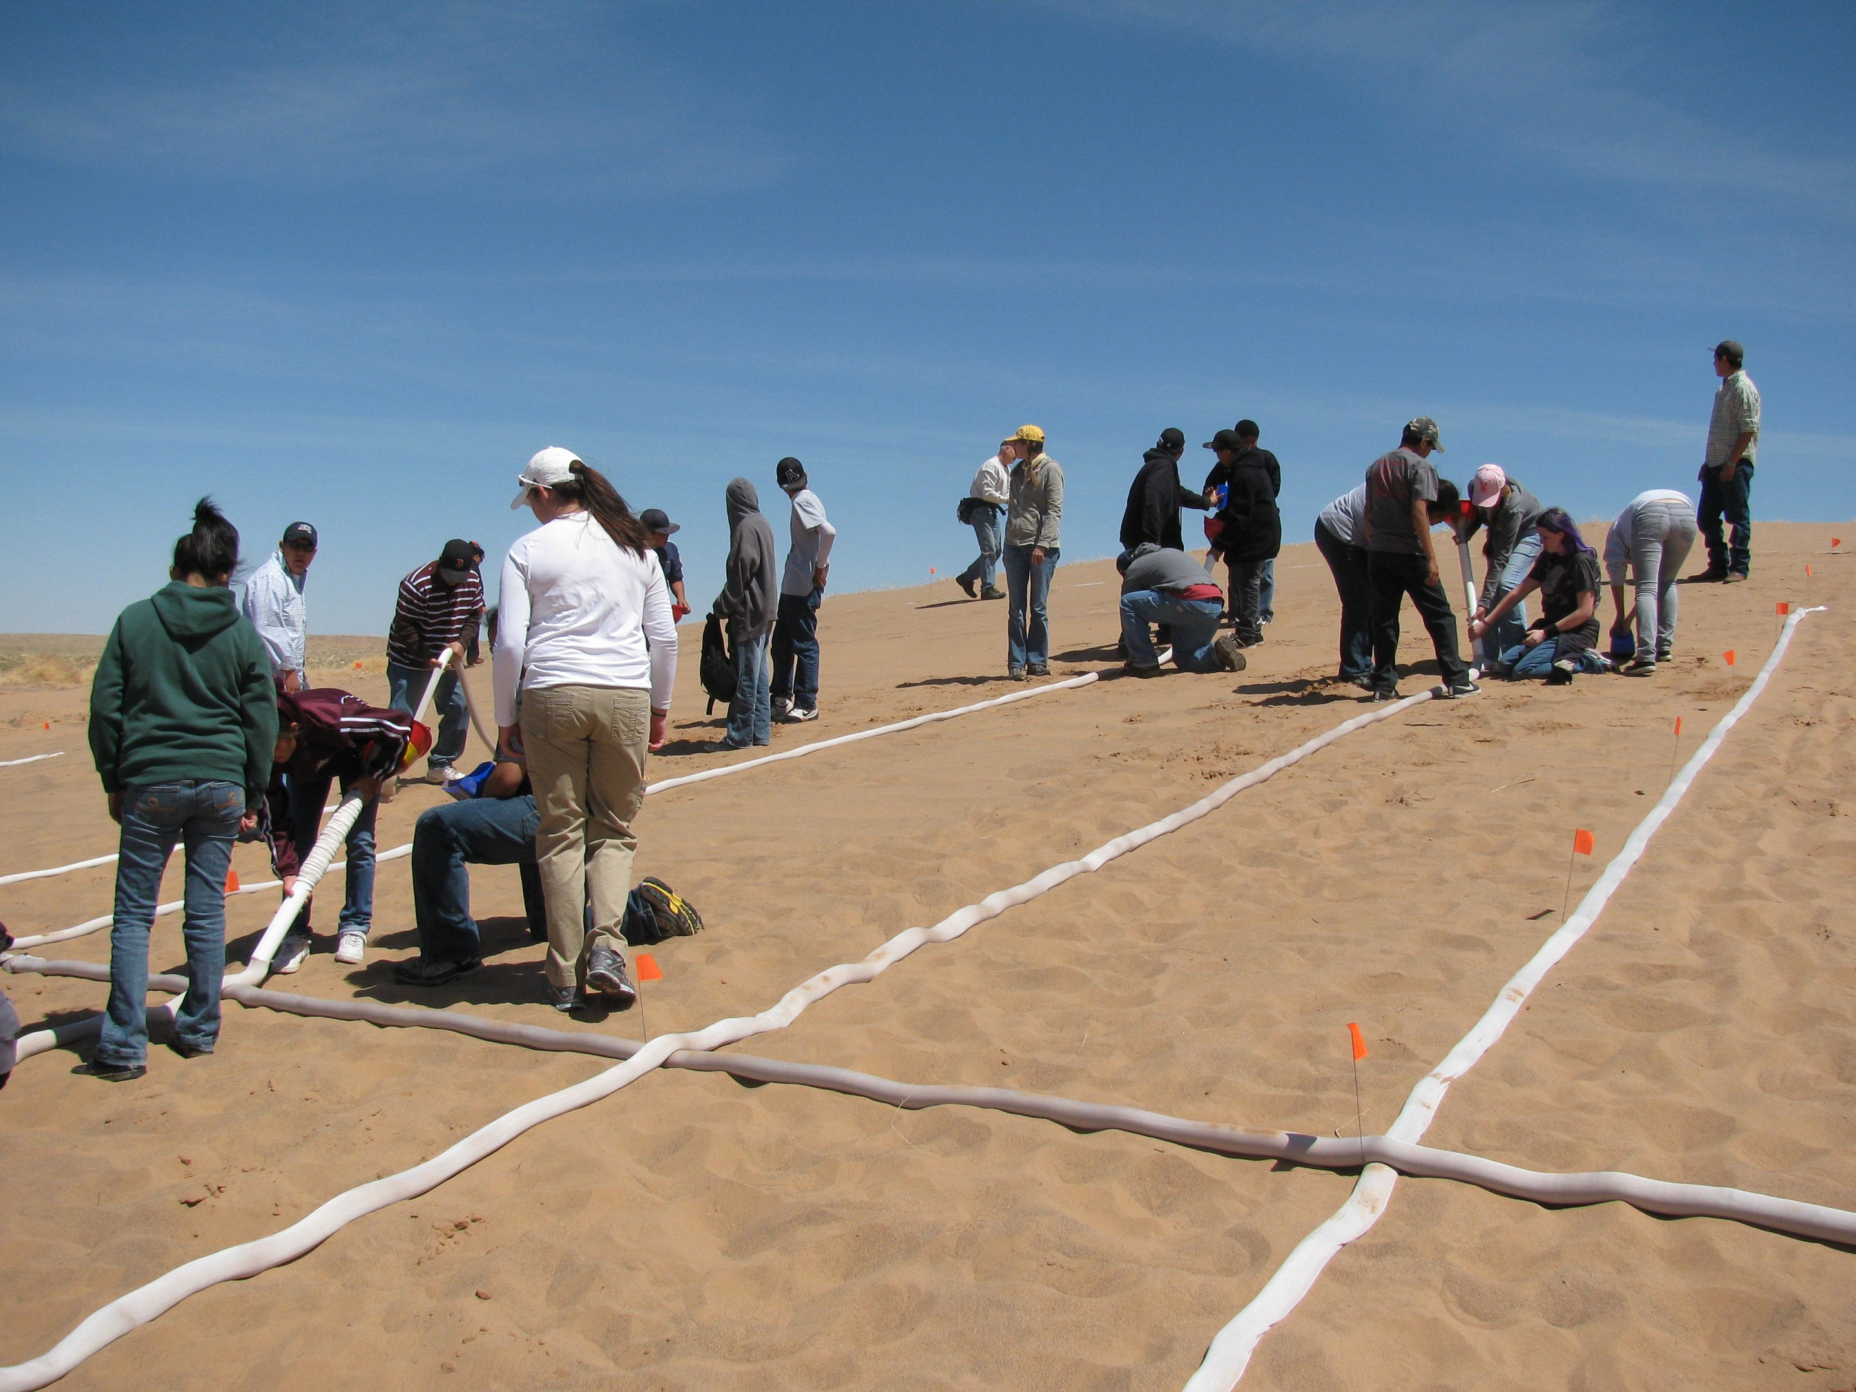

Why Engage in Outreach?
Outreach goals:
Introduce Climate Change and mitigation strategies
Introduce renewable energy
Plant “seeds” for up coming potential scientists and engineers

Slide 3
Who was the target population?
Minority students in the Flagstaff area
Grades 5th grade to 12th grade

Slide 4
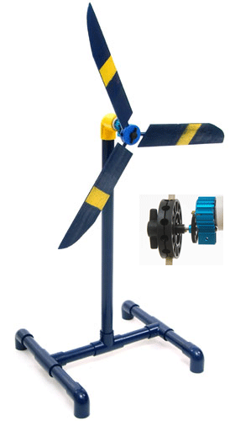
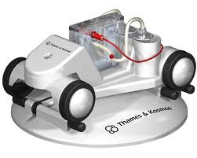
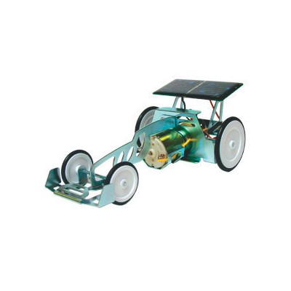
What we taught..
Wind power
Solar power
Hydrogen fuel cells

Slide 5

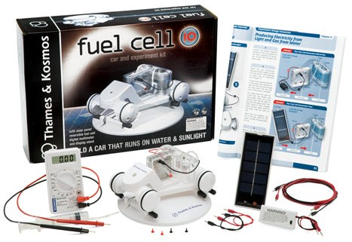
How we taught…
Used interactive “kits”
KidWind Kits and Curriculum
Thames & Kosmos fuel cell

Slide 6
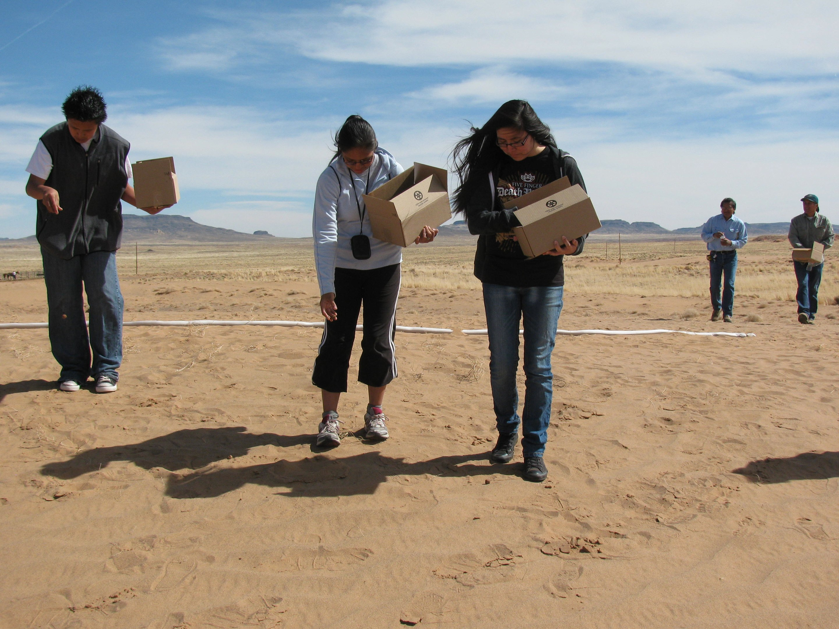
Outcome of internship
I Learned a lot
Students gained exposure to science and engineering applications
Made a positive impact

Slide 7



Thank you
Environmental Protection Agency
Graylnn Hudson
Christiana Gonzales
NAU NASA Grant program
Mansel Nelson

Slide 8

THANK YOU

